Slide 1
SALES PERFORMANCE DASHBOARD
Power BI Dashboard Project
Prepared By: Himadri Singh
Tools Used:
• Power BI
• DAX
• Data Visualization
• Interactive Dashboarding

Slide 2
PROJECT OVERVIEW
Objective
The objective of this project was to design an interactive Sales Performance Dashboard using Power BI that enables stakeholders to monitor business performance through key metrics and visual insights.
The dashboard provides a centralized view of sales, profit, customer performance, and regional trends, helping decision-makers identify opportunities and make data-driven decisions.
Dataset: Sample Superstore Dataset
The dataset contains information related to:
• Sales
• Profit
• Orders
• Customers
• Product Categories
• Regions
• Order Dates

Slide 3
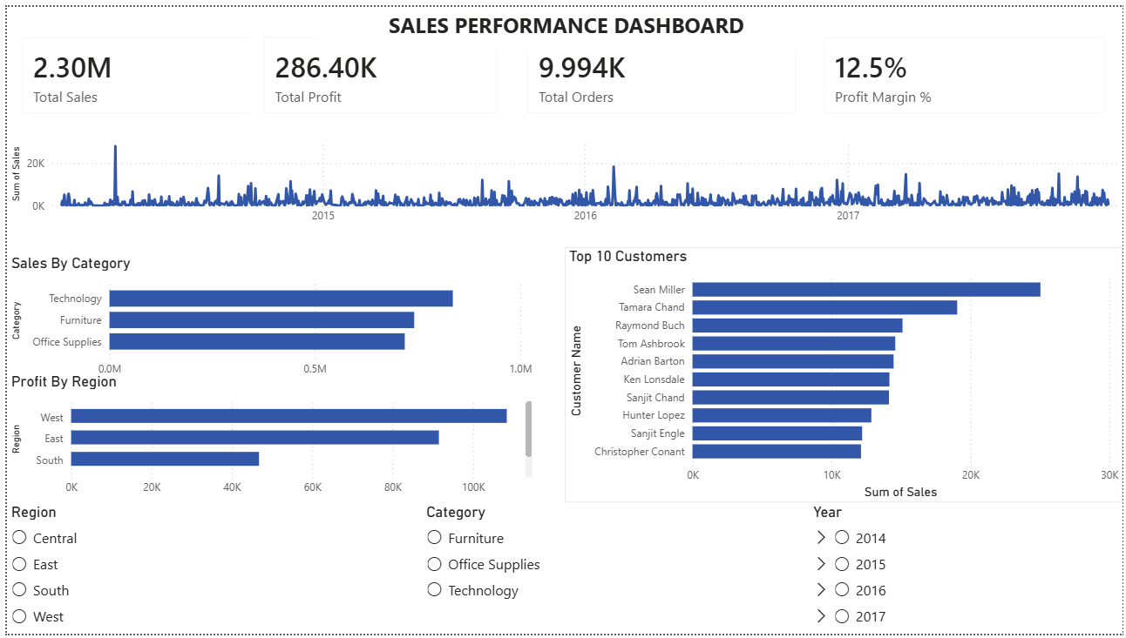
DASHBOARD OVERVIEW

Slide 4
KPI ANALYSIS
The dashboard provides a quick summary of business performance using KPI cards.
Total Sales
Represents the overall revenue generated by the business during the selected period.
Total Profit
Displays the total profit earned after accounting for costs.
Total Orders
Shows the total number of orders processed.
Profit Margin %
Measures profitability by comparing profit against total sales.
These KPIs provide an immediate overview of organizational performance.

Slide 5
Key Insights
Sales performance can be monitored over time through the trend analysis chart.
Certain product categories contribute significantly more revenue than others.
Profitability differs across regions, highlighting areas of stronger business performance.
A small group of customers contributes a substantial portion of total sales.
Interactive filters allow users to perform deeper regional and category-level analysis.

Slide 6
DAX Measure Used
Profit Margin Calculation
Purpose
This measure calculates the percentage of profit generated from total sales and serves as a key indicator of business efficiency.

Slide 7
Business Value
Benefits of the Dashboard
Provides a centralized view of business performance.
Enables faster decision-making through real-time insights.
Helps identify high-performing customers and categories.
Supports profitability analysis across regions.
Improves stakeholder understanding through interactive visualizations.

Slide 8
Conclusion
Summary
The Sales Performance Dashboard successfully transforms raw business data into actionable insights through interactive visualizations and KPI monitoring.
Outcome
Improved visibility into sales and profit performance.
Enhanced analytical capabilities through filtering and drill-down functionality.
Demonstrated practical use of Power BI for business intelligence reporting.

